Slide 1


Analysis of Myntra Apparel Dataset
Data Cleaning, Data Analysis & Excel Functions Case Study
Your Name: Rakshitha J
Course Name: Data Analysis
Institution Name: WsCube Tech
Date: 29-07-2026
Date.
XX – XX - XXXX

Slide 2
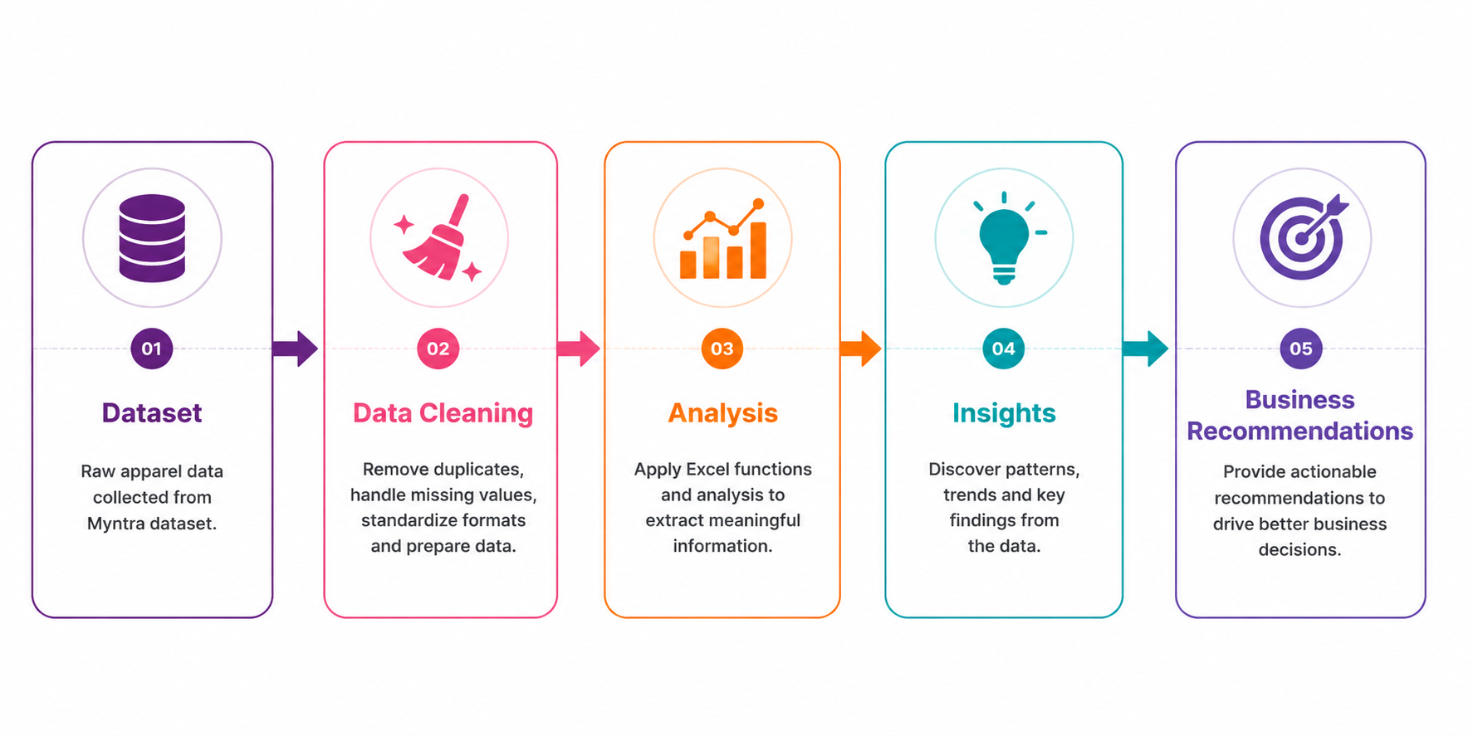
Business Problem:
Management wants to analyse the apparel dataset to understand
Pricing trends
Discounts
Product ratings
Available sizes
Missing values
Product lookup using Excel functions
Objective
Generate business insights using Excel data cleaning, analysis, and Lookup functions.
Analysis Workflow:

Slide 3
Dataset Overview:
Source: Myntra Apparel Dataset | Row: 1048575 | Column: 13
Feature | Description
URL | Link to the product page on Myntra
Product_id | Unique identifier for each product
BrandName | Name of the brand selling the product
Category | Broad product category (e.g., Apparel, Footwear)
Individual_category | Specific product type within the category (e.g., T-Shirt, Kurta)
category_by_Gender | Target gender segment (Men / Women / Unisex)
Description | Short text description of the product
DiscountPrice (in Rs) | Price after discount is applied (₹)
OriginalPrice (in Rs) | Actual listed price before discount (₹)
Discount Offer | Discount percentage offered on the product
SizeOption | Available sizes for the product
Ratings | Average customer rating
Reviews | Number of customer reviews received
Why it matters:
"This dataset contains apparel product information — pricing, discounts, ratings, and sizes — used as the foundation for every insight and recommendation in this analysis."
03
03

Slide 4
Data Cleaning Process
Removed Duplicates:
Identified and removed duplicate product records to ensure accurate counts.
Standardised Discount Offer:
“RS 400 “ OFF >> unified to “40 % OFF”.
=ROUND((I2-H2)/I2*100,0)&"% OFF"
2
1
Filled Missing Discount Price:
Used the average discount price of the respective category (AVERAGEIF).
=IF(AND(H2="",J2=""),AVERAGEIF($D:$D,D2,$H:$H),H2)
3
Replaced Missing Size Option:
Blank/ NULL values >> replace with “Not Available”.
4

Slide 5
Excel Functions Used
Excel Function | Purpose in the Myntra Case Study
Remove Duplicates | Checked the dataset for duplicate records and removed duplicate entries.
IF | Classified products as High Discount (>50% OFF) or Low Discount (≤50% OFF).
AVERAGEIF | Filled missing DiscountPrice values with the average discount price of the respective category.
COUNTIF | Counted the number of products available in size "M".
AVERAGEIF | Calculated the average Original Price for products with ratings greater than 4.
COUNTIF / COUNTIFS | Counted products with DiscountOffer greater than 50% OFF.
VLOOKUP | Retrieved the Brand Name, Discount Price, and Ratings using the Product ID.
XLOOKUP | Retrieved product details dynamically using Product ID.
Nested XLOOKUP | Retrieved any column's information (Brand, Price, Rating, etc.) by combining Product ID and column name.
INDEX + MATCH | Retrieved the DiscountPrice for Product ID 6744434.
ROUND | Rounded calculated discount percentages to the nearest whole number.
ABS | Converted negative discount percentages into positive values where required.
QUICK REFERENCE (FORMULAS):
=IF(DiscountOffer>50,"High Discount","Low Discount")
=AVERAGEIF(Category,A2,DiscountPrice)
=XLOOKUP(ProductID,ID_Range,Return_Range)
=INDEX(Range,MATCH(ID,ID_Range,0))

Slide 6

Analysis Result :
Avg. Original Price (Rating > 4):
=AVERAGEIF(Ratings,">4",OriginalPrice)
Products with >50% OFF:
=COUNTIF(DiscountOffer,">50%") (or COUNTIFS if DiscountOffer is text like "60% OFF").
Products Available in Size ‘M’:
=COUNTIF(SizeOption,"*M*").
Overall Average Rating:
=AVERAGE(Ratings)

Slide 7
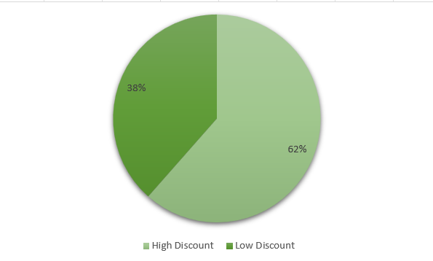
Discount Classification
=IF(DiscountOffer>50,"High Discount","Low Discount")
High Discount — discount offer greater than 50%
Low Discount — discount offer 50% or less
Interpretation "Use this classification to spot which products are being sold at steep discounts — useful for tracking margin impact and planning future promotions."

Slide 8




Types of Statistics
VLOOKUP
INDEX + MATCH
Nested XLOOKUP
Product ID: 11226634
Product ID: 6744434
Discount Price
Any field - Dynamic
Brand Name
Discount Price
Rating

Slide 9
Key Insight & Recommendation
INSIGHTS:
RECOMMENDATION:
Premium products generally show higher customer ratings.
50% discounted products attract higher purchase interest.
Size 'M' has the highest availability across categories.
Missing values were resolved, improving data reliability.
Standardizing discount formats improved reporting accuracy.
Increase stock for high-demand sizes like M.
Maintain discounts in the 40–60% sweet spot.
Improve data quality checks at product upload.
Monitor product ratings on a regular cadence.
Build a live dashboard for real-time tracking.

Slide 10

Conclusion
From Raw Data to Business Decisions
"This project demonstrated the complete data analytics workflow using Microsoft Excel — from data cleaning and analysis to lookup functions and business insights that support real decisions.“
Data Cleaning · Data Analysis · Lookup Functions · Business Insights · Decision Support
Thank You

